Slide 1


Chapter 11: Real-world Research
Foundations of Social Work Research

Slide 2
Learning Objectives
Describe how to conduct evaluation research
Define inputs, outputs and outcomes
Identify the three goals of process assessment
Identify why social workers might use single subjects design
Describe the two stages of single-subjects design
Define and provide at least one example of action research
Describe the role of stakeholders in action research

Slide 3
Types of Evaluation Research
Needs assessments
Process evaluations
Outcome evaluations
Efficiency analyses
Cost-benefit analysis
Cost-effectiveness analysis
Notes:
In this class, we will focus on process evaluation & outcome evaluation

Slide 4
Evaluation Research
Inputs -> Program Process -> Outputs -> Outcomes
Stakeholders: individuals and groups with interest in program
Inputs: clients, customers, people, etc.
Program process: activities that constitute the program or intervention
Outputs: direct products (# clients served, staff trained, meals delivered, etc.)
Outcomes: impact of program process

Slide 5
Outcome Assessment
Conducted to answer the question of how effective programs/policies are
(looks at outcomes)

Slide 6
Process Assessment
Evaluates a program in its earlier stages
3 main goals
Program description
Program monitoring
Quality Assurance
how the program looks for clients and staff
tracking how services are provided and utilized
how clients experience the program
Notes:
Three main goals:

Slide 7
Diversity in evaluation research
Cultural competence in evaluation is critical!
Race, ethnicity, sexual orientation, gender identity, community, academic versus practice, etc.
All the issues of diversity that come into play in research are also considerations in program evaluation
The results of program evaluation apply directly to a program’s clients and will have a direct consequence for them; this relates to justice

Slide 8
Single-Subjects Design
Focuses on the individual case, not average among a sample
Repeated measurements over time
Starts with a baseline phase (A) prior to intervention
Measurements continue through the treatment period (B)

Slide 9
Baseline phase
Abbreviated by the letter A
No intervention during the baseline
Repeated measurements are taken until a pattern emerges
Similar to the control group in experimental design (i.e., it shows what happens without the intervention)
Minimum of 3 measurements are needed, but often more are needed
Stable; Trend; Cycle

Slide 10
Treatment phase
Begins after the baseline phase
Should be as long or longer than the baseline
Represented by the letter B
Intervention is administered

Slide 11
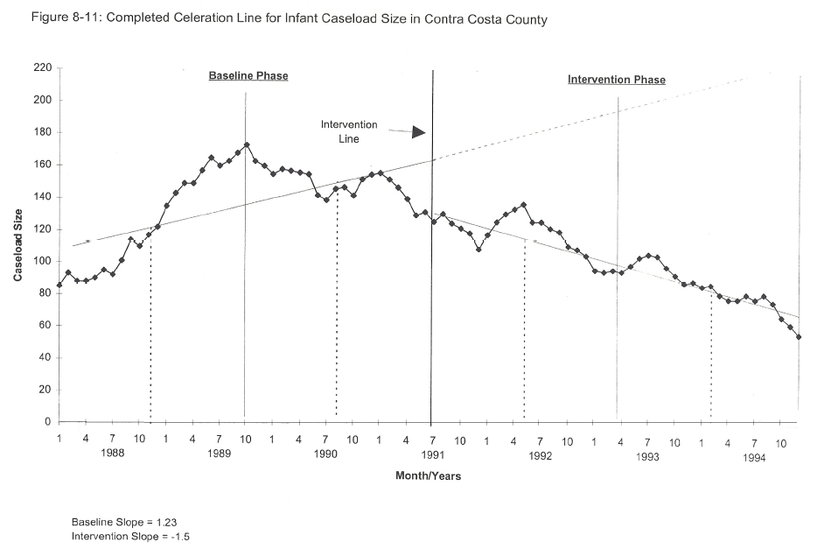
Visual representation of a single-subjects study
Rogers, K., Ferguson, C., Barth, R. P., & Embry, R. (1997). Evaluating community-based programs for families at-risk of foster care placement: An empirically based curriculum. Retrieved from https://www.oercommons.org/courseware/module/21448.
Licensed: CC 4.0 BY-NC
A
B

Slide 12
Single-Subjects Design
Benefits
Challenges
Baseline may be unethical or impractical
Pattern can be difficult to discern
Conducive for social work practice
Not generalizable
Can measure multiple outcomes in a variety of ways

Slide 13
Action Research
Stakeholders – those in the community with a interest in your study; in action research the emphasis should be put on those stakeholders who have the least power
Research that is conducted for the purpose of creating social change

Slide 14
Action Research
Assumptions (Healy, 2001)
Oppression is caused by macro-level structures
Research should expose and confront the powerful
Researcher and participant relationships should be equal
Research should result in consciousness-raising and collective action

